Slide 1
Insights From the 2023 Digital Outlook Report
afpicon.com
#afpicon

Slide 2
Today’s speakers
Salvatore Salpietro
Mike Johnston
Chief Partnership Officer, Fundraise Up
Founder & President, hjc

Slide 3
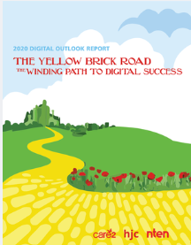
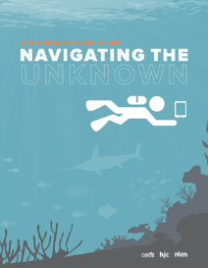
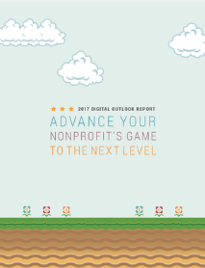
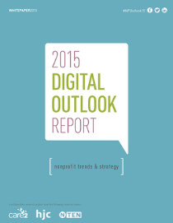
2015-2020
DigitalOutlookReport.com

Slide 4
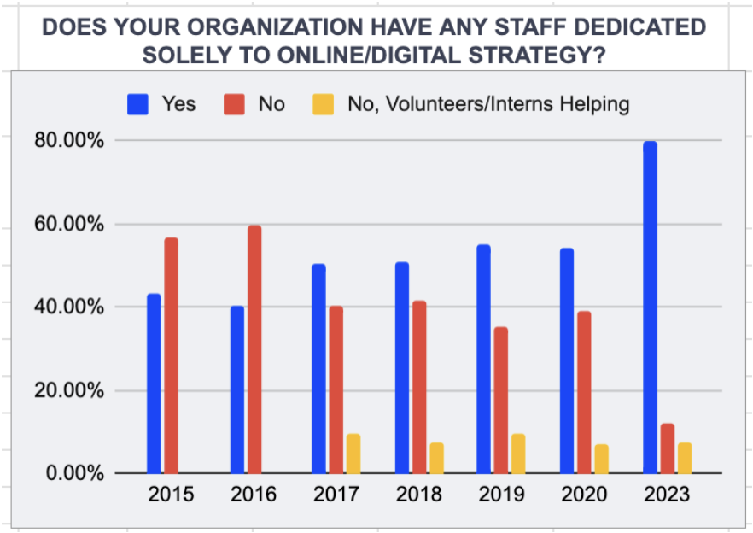
80% of organizations have staff dedicated solely to online/digital strategy
54.17% in 2020’s digital outlook report
We’re now seeing digital become a focal point within organizations
However
12.31% of organizations have no one person solely dedicated to online/digital

Slide 5
45% of organizations claim the entry point of their digital staff consists of existing staff who added on new digital skills
We are seeing adaptability, awareness, and a willingness to train from within
Organizations who’ve lost their digital staff are exploring new ways to adapt by hiring:
Acquiring proven nonprofit digital workers as the talent wars heat up (35.38%),
Volunteers who become staff (24.62%),
Proven digital workers hired from the commercial sector (24.62%), and
New graduates from universities and colleges (21.54%).

Slide 6
Organizations experienced a ¾ difficulty when finding & hiring digital staff
Savvy social impact organizations are building pipelines to local colleges and universities e.g. getting to know administration and professors so they can reach into classes and introduce our sector to near graduates.

Slide 7
53% of organizations found a ¾ & above difficulty to retain staff
This is not unusual and is happening in all industries
It’s hard for nonprofits to compete in staffing in the digital sector
Now is the time to push hard and get talent as major layoffs are taking place
How do you make yourself stand out and be attractive? Offer prospects what the commercial sector can’t:
7.5 hour work days
30-40 hours a week
Work virtual all around the world
Shutdown for 2 weeks during the year separate from the holidays
Professional Development and more…

Slide 8
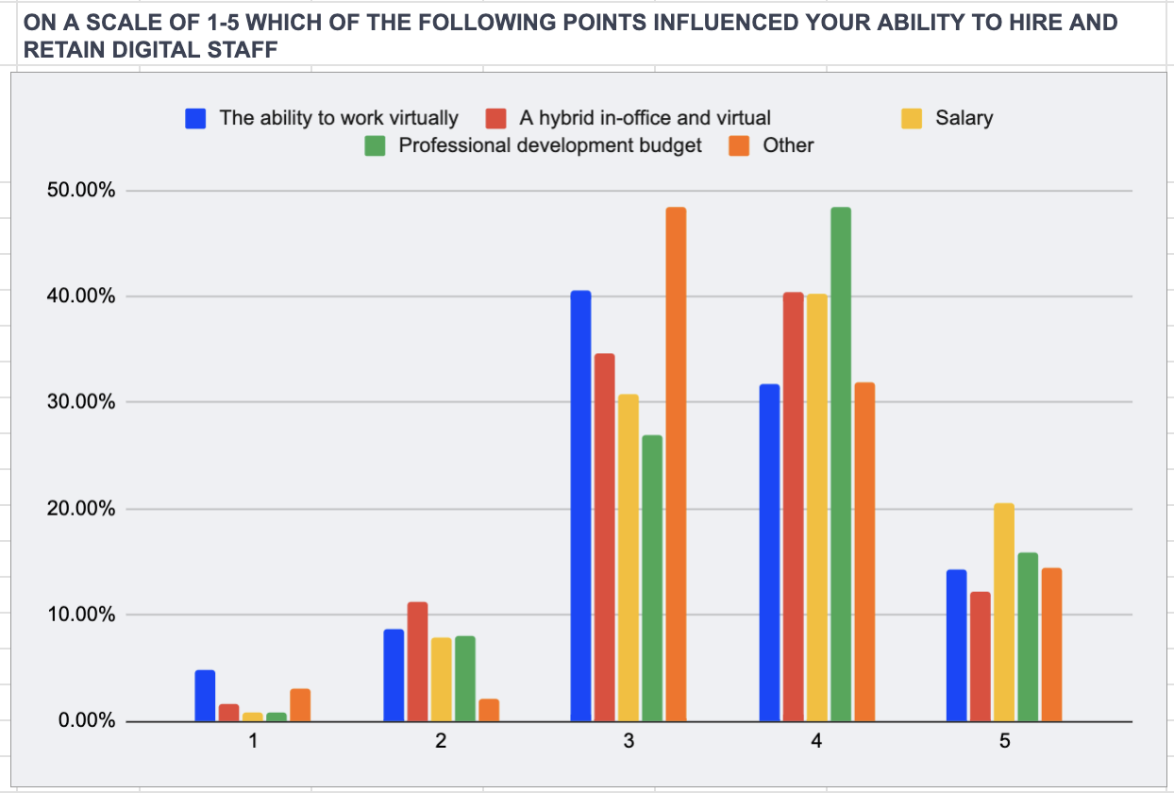
What is holding organizations back when hiring & retaining digital staff?
Salary
Hybrid in-office and virtual workplace - proves that flexible work environments is an untapped bonus to entice potential candidates
Having a professional development budget shows newcomers they will grow within your organization, and current staff that they’re worth being invested in

Slide 9
It’s not just the social impact sector
70% of the workforce actively looks for or thinks about new opportunities, and
91% of millennials expect to change jobs every three years.
The unemployment rate is decreasing, which means the pool is getting smaller.
Q1 2023 | 2015 - The first digital outlook report
U.S. is 3.6%, 3.7% in the U.K., and 5.0% in Canada, | 5% in the U.S., 5.3% in the U.K. and 6.9% in Canada.
These stats are not meant to scare organizations, rather to put things in perspective. Organizations must get creative to stand out from the rest and change the minds of their internal staff, who might already be looking for new opportunities.

Slide 10
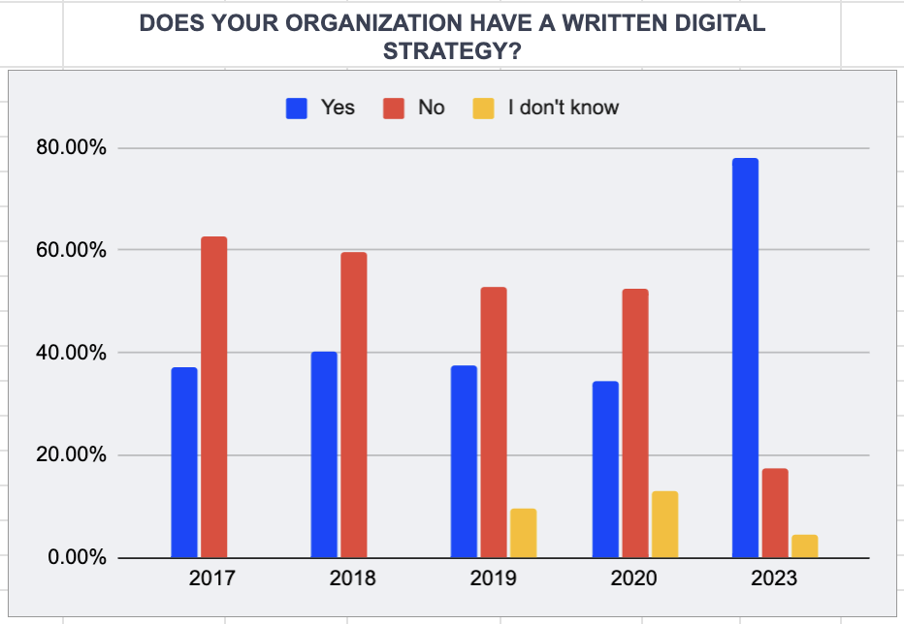
78% of organizations have a written digital strategy
34.63% in 2020’s digital outlook report
However
17.52% of organizations do not have one, and
37.70% of nonprofits are struggling with an unclear or missing vision/strategy
Nonprofits need to make sure all members are on the same page and understand the organization's goals and how to achieve them

Slide 11
A lesson from Peter Drucker
“
Drucker, one of the most widely-known and influential thinkers on management, said:
Unless commitment is made, there are only promises and hopes... but no plans.
Peter Drucker

Slide 12
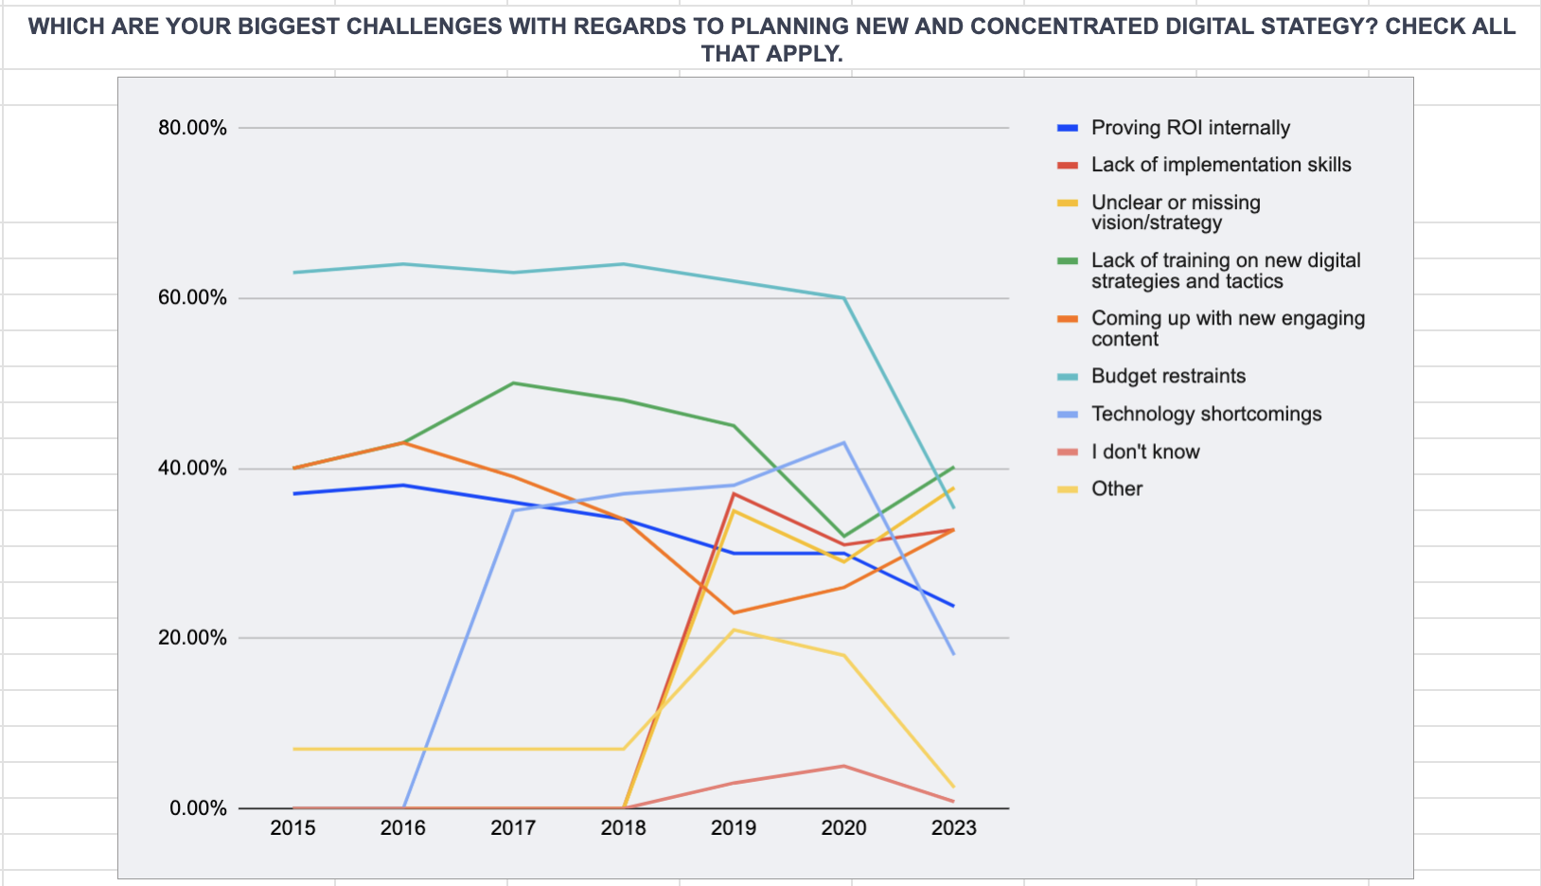
40% of nonprofits find a lack of training on new digital strategies & tactics to be their biggest roadblock
When planning a new and concentrated digital strategy, nonprofits can counteract the lack of training on new digital strategies and tactics by:
Seek out online resources,
Bringing in outside help, and
Attending industry events

Slide 13
New platforms every day
Countless numbers of AI platforms and systems have been released this year alone and more are sure to come.
OpenAI announced on March 23, 2023, that ChatGPT, now GPT-4, will have the capability to host plugins meant to beef up the platform. So far there are 11 official plugins available but this number will get much higher, very quickly.

Slide 14
1/5 organizations are saying they don’t plan on starting an sms program
Research your audience to know if this is right for you
The average person will send 25% more texts than emails
The open rate for SMS texts are 98% percent
Different ways to utilize SMS text messaging:
Thank you,
50/50 Lottery,
Fundraising (Giving Tuesday), and
Reactivation and upgrade

Slide 15
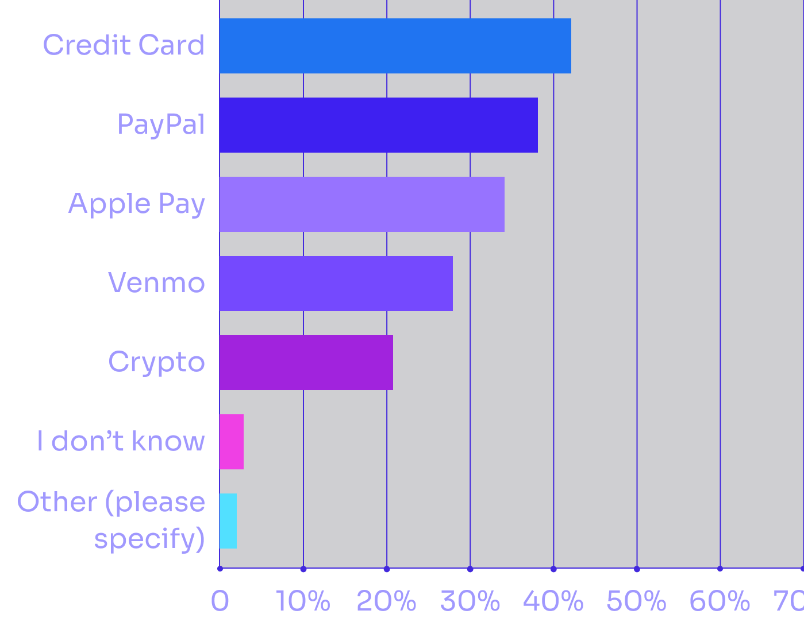
Online Revenue Streams & Diversifying
For 20 years we mostly saw credit card and PayPal reign supreme
Now we see new payment methods such as Crypto, Venmo, and Apple Pay as main sources of income
Make sure to provide all payment methods on your donation form
2009
and on
Past 20 years

Slide 16
26% of nonprofits giving experience do not share a similar domain
Build Trust with your donors
Increase your brand recognition
Make the donation process as convenient as possible for your donors
Reduce the risk of online scams and increase the level of security for your donors

Slide 17
44% of organizations are not taking advantage of google ad grants
Only 1% of organizations started using Google ad grants since the 2020 Digital Outlook Report and 11% since the 2019 report
If we don’t start using this service, Google will get rid of it
Take advantage of the service instead of creating our own demise
It DOES take skill and effort to maximize the GIFT from Google

Slide 18
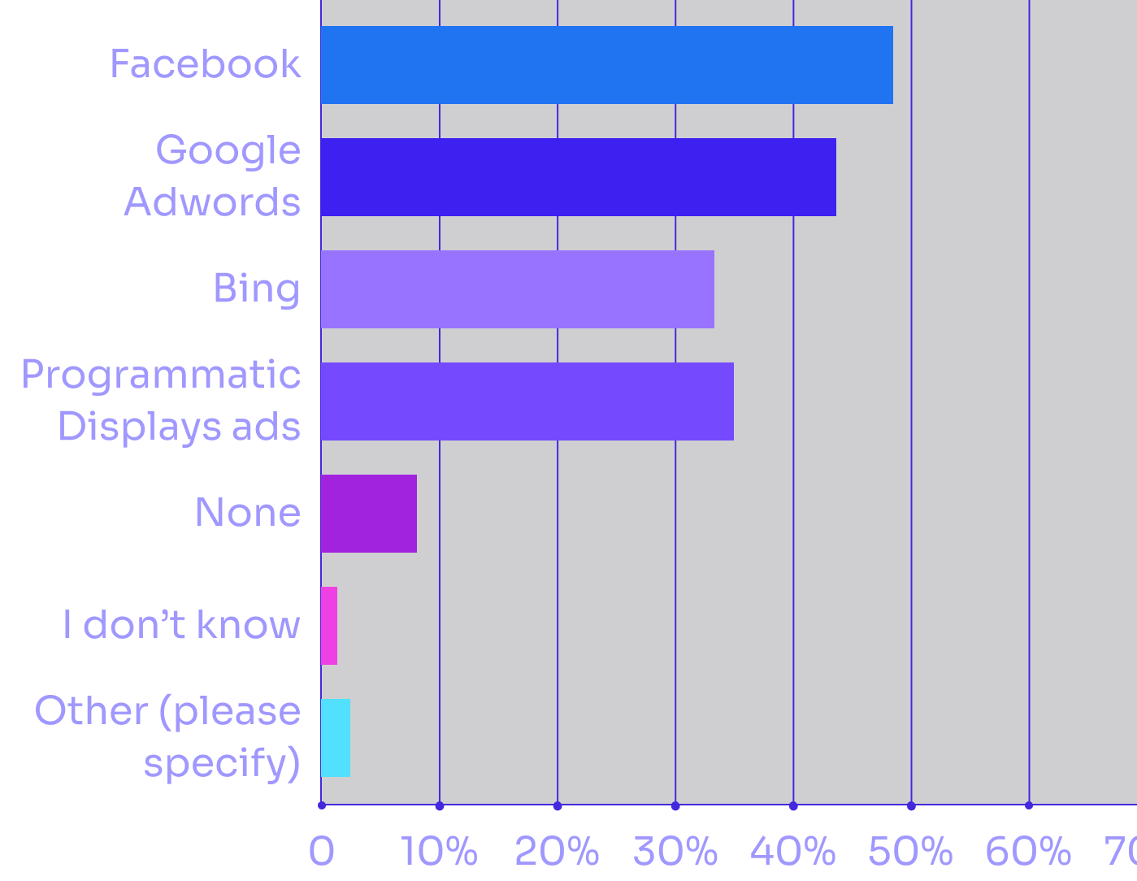
34% of organizations use bing for remarketing / retargeting?
This is a 27% increase from 2020
As Microsoft successfully integrates ChatGPT and launches Bing 2.0, organizations must be ready to meet donors who are testing/moving to their new the search engine of choice.

Slide 19
49% of organizations plan to focus more on influencers in 2023
There are many different ways to attract and utilize influencers within your digital strategy, such as:
An ambassador for your organization,
Social media collaboration between your organization and the influencer,
Social media takeover where the influencer is in charge of your social media accounts for a period of time, and
E-gamers / online personalities can help fundraise through live streams or e-gaming tournaments

Slide 20
Overall fundraising budget earmarked for digital spend in 2023
12%
Organizations are planning an average digital spend of 52% while
in 2020 it was 40%
Let’s remembers - The organizations who answered are skewed more to a digital bent (and this was an online survey)

Slide 21
44% of nonprofits use inbound marketing for their lead generation
12% in 2020’s digital outlook report
Inbound Marketing Method:
Attract with blogs, search engine optimization (SEO), link building, keywords, and social media presence
Convert with forms, a call-to-action, and a landing page
Close with CRM, email, and workflows
Delight with surveys, social listening, and S.M.A.R.T content (specific, measurable, actionable, realistic, timely).

Slide 22
Digital acquisition & retention strategies split in half
Decide what your strategy is: growth or maximizing net revenue
Strategy is not just splitting it down the middle: avoid the story of King Solomon
Make sure you have empirical, statistical and tactical reasons
for your spending in each of the two areas

Slide 23
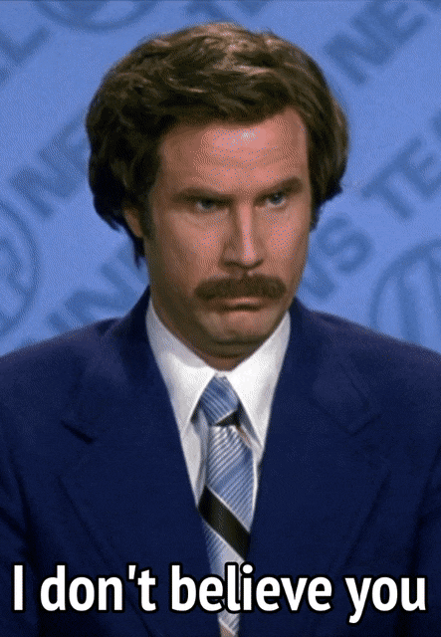
What is your renewal rate for one-time digital donors?
Organizations claimed they had an average renewal rate of 56%
2022 M+R Report
First time gift = 23%
Repeat donors = 60%

Slide 24
Omnichannel approach
in 2023
Social media reigns supreme for a 48% increase overall budget in 2023
Email is still important at 34%
Organizations plan to increase their Telemarketing approach by 30%
Organizations are planning a digital
and offline approach in 2023
A charity - making $150,000/month - cut off from Facebook fundraising because one document had a different address than another from an office move.

Slide 25
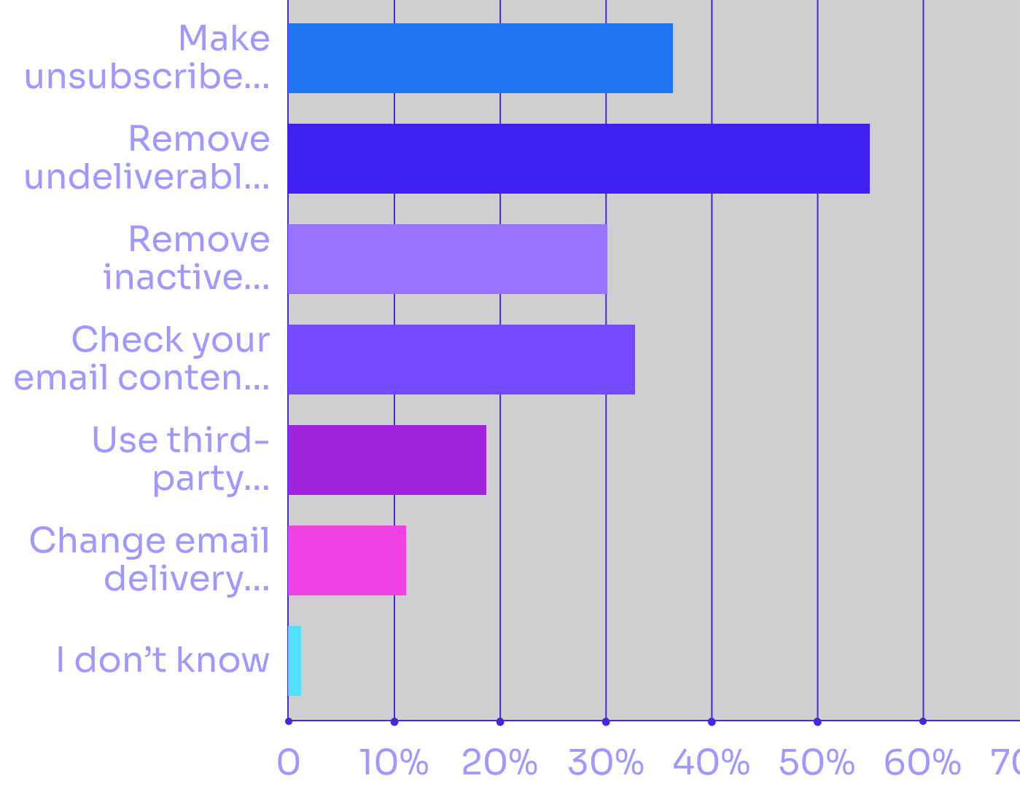
Improving email deliverability
Data hygiene is as important as ever
Use third party email validation services such as:
MailFlow
Mail Tester
Spamhaus
CheckMX
Sender Score

Slide 26
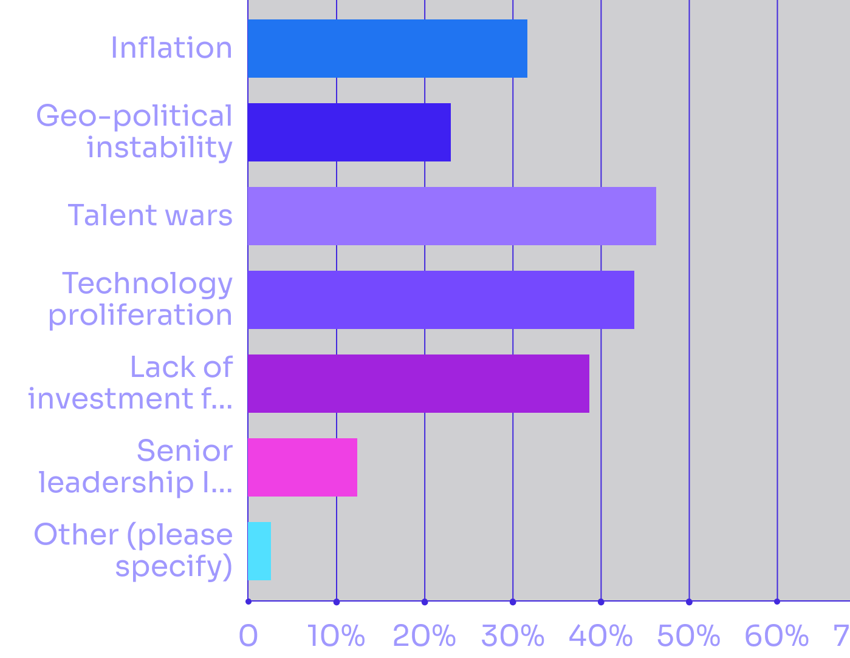
What influences do you think will have the biggest impact on your digital in 2023 & beyond?
Talent wars
Technology proliferation
Lack of investment for digital
AI & Machine Learning

Slide 27
Are there any keys to unlocking digital’s potential?
People matter - even with digital - find improved ways to find them AND to keep them
Limited resources means carefully planning on what to spend on: strategy needs to tie to spending decisions (grown, retain, etc.)
New thing appear quickly in digital: Bing, Venmo, Crypto. Be ready for what’s next
Don’t leave money on the digital table: Google Grants

Slide 28
Questions?

Slide 29
Thank you!
Please visit us at Booth 619 to continue the conversation.

